Slide 1
Geographer’s Toolkit
Geography of Canada
www.CraigMarlatt.com/school

Slide 2
Geographer’s Toolkit
Parts of a Map
  Map Symbols
  Mapping Your Location
Types of Maps
Political Map of Canada
Drainage Map of Canada
Pear Island Mapping Exercise

Slide 3
What is a Map?
A map is a representation of the Earth’s features drawn on a flat surface.
Maps use symbols and colours to represent features of an area, simplifying the real world.

Slide 4
Features on a Map
Title – identifies the area shown, topic, focus, or purpose of the map
Legend – explains the meaning of symbols and colours used on the map
Scale – represents the relationship between distance on the map and distance in the real world
Direction – often represented with an arrow
Border – sets the map apart from other information
Date of Publication – indicates how recent the map is

Slide 5
Map Labelling & Colouring
Cartography is the art of drawing accurate, easily readable, attractive maps.
Labels
  Should be neatly printed
  Should be spelled correctly
  Should be parallel to the base of the map (except for natural features such as rivers and mountain ranges)
  A dot should be used to locate cities, with the name of the city as close to the dot as possible.

Slide 6
Map Labelling & Colouring
Labels (continued)
  Larger features usually have larger labels
  Labels for similar features should be the same size and font – for example:
    Water Body
    City
    PROVINCE
    C O U N T R Y
  Labels should not block other information on the map

Slide 7
Map Labelling & Colouring
Colouring
  Maps should be properly colour coded to show the different areas on the map
  Shade consistently so that there are no light or dark patches of one colour within one feature
  Use solid colours only, not shading patterns
  White or black are not acceptable shading colours
  Grey should be used for areas not important to the map
  Blue should only be used for water bodies

Slide 8
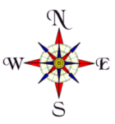
Points on a Compass
A compass is a way of finding direction
The four cardinal points are N, E, S, W
The twelve ordinal points are NE, SE, SW, NW, NNE, ENE, ESE, SSE, SSW, WSW, WNW, NNW
The points all have corresponding degrees of a circle (0° → 360°)

Slide 9
Lines on the Earth
Latitude
  imaginary lines that measure the distance north or south of the Equator (0°)
  lines are parallel to the Equator at regular intervals (approximately 111 kilometres apart)

Slide 10
Lines on the Earth
Longitude
  imaginary lines that measure the distance east or west of the Prime Meridian (0°)
  all lines begin and end at the poles and therefore are not at a fixed distance apart
  the Prime Meridian (0°) was arbitrarily chosen at a point that runs through Greenwich, England
  the International Date Line (180°) is the point where one day begins and one day ends

Slide 11
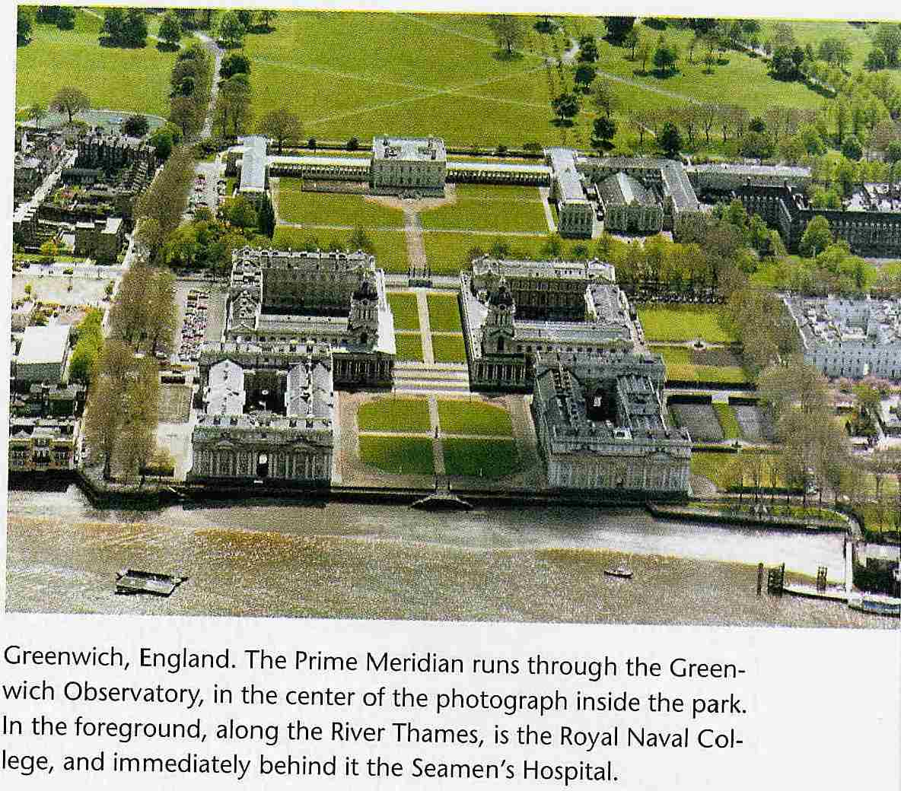
Lines on the Earth
The Prime Meridian

Slide 12
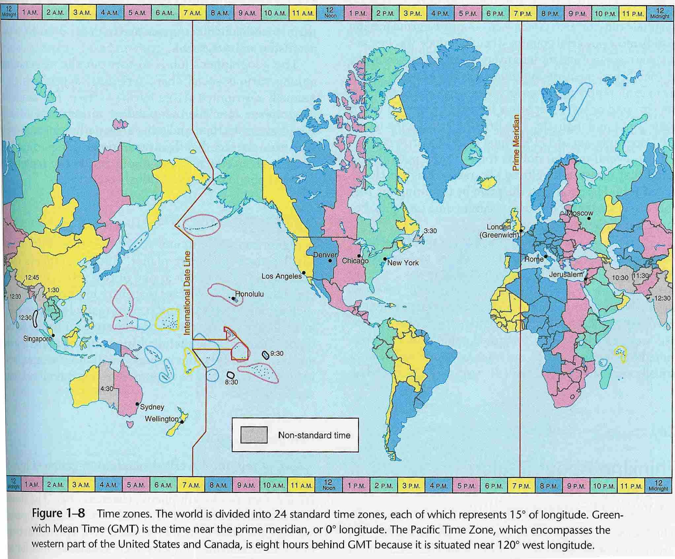
Lines on the Earth
There are 6 time zones in Canada
Time Zones

Slide 13
Scale
Scale shows the relationship between the distance on a map and the actual distance on the Earth’s surface
  Direct Statement Scale uses words to describe what a distance on a map represents in the real world
    1 cm = 10 kilometres
  Linear Scale uses a special ruler on a map to show what a distance on a map represents in the real world
    0 km 400 km
  Representative Fraction Scale is a ratio where one unit on a map represents a specific number of the same unit in the real world
    1:50 000 (1 cm on the map represents 50 000 cm in the real world)

Slide 14
Scale
 | Area | Detail | Example
Large Scale Maps | Small | A lot (streets, schools, railways, …) | Topographic maps, road maps, city bus maps
Small Scale Maps | Large | A little (borders, lakes, large rivers, …) | Globes, world maps, atlases

Slide 15
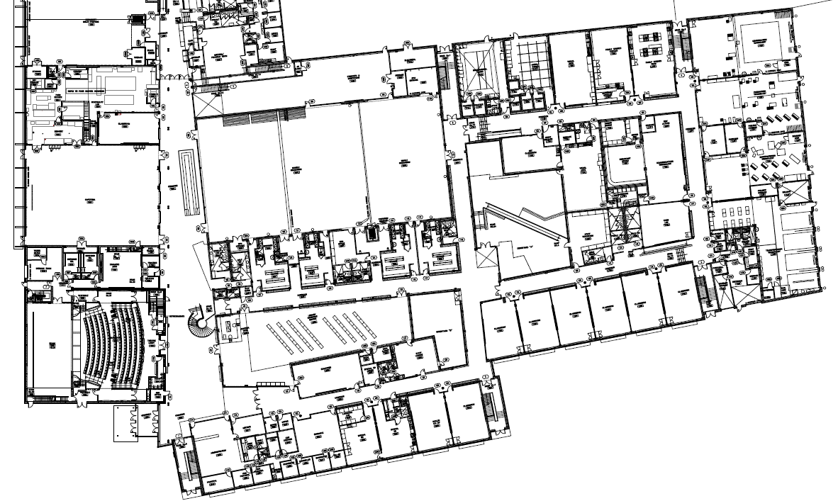
Scale – Mapping Our Location
BMLSS- 1st floor
You are here!

Slide 16
BMLSS & Sportsplex
You are here!

Slide 17
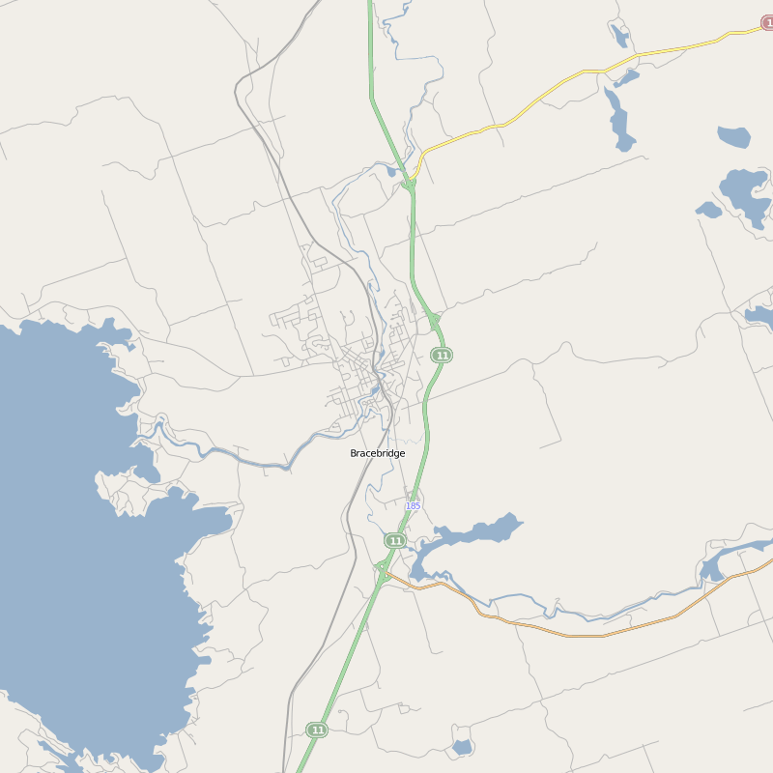
Bracebridge
Bracebridge
You are here!

Slide 18
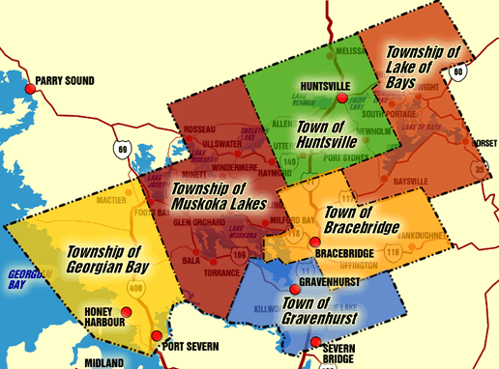
District of Muskoka
You are here!

Slide 19
Scale – Mapping Our Location
Southern Ontario Map
You are here!

Slide 20
Scale – Mapping Our Location
Ontario Map
You are here!

Slide 21
Scale – Mapping Our Location
Canada Map
You are here!

Slide 22
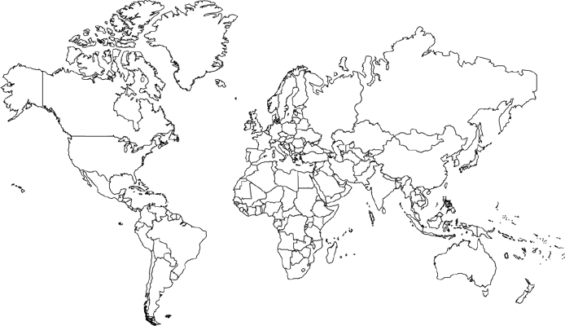
Scale – Mapping Our Location
World Map
You are here!

Slide 23
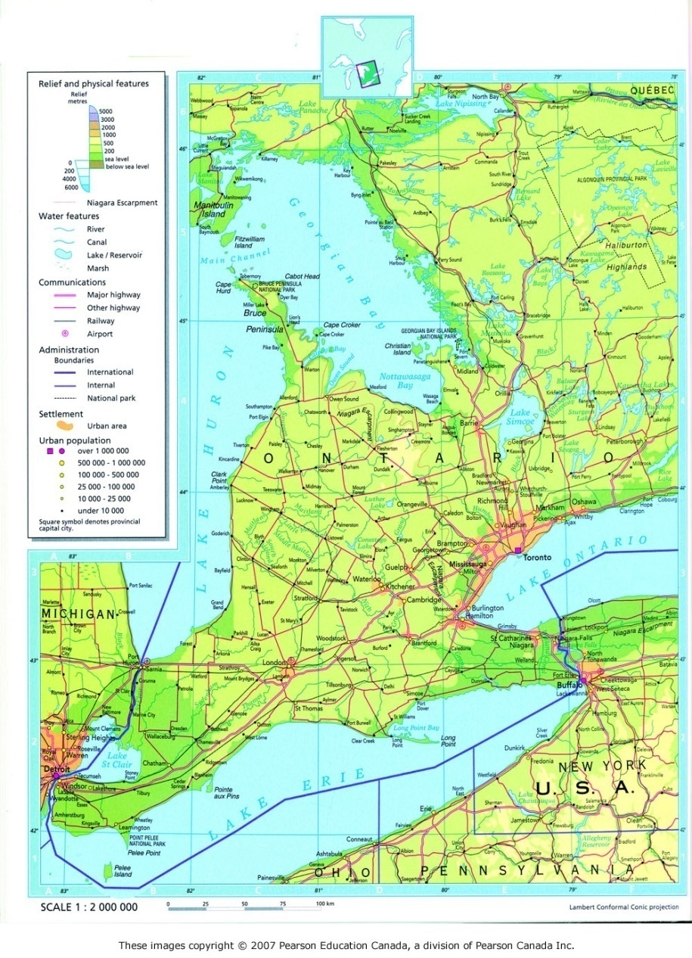
Types of Maps
General Purpose Maps
  A map drawn to scale using symbols and colours to indicate major roads for transportation purposes
  Often includes parks, hospitals, and tourist attractions
  Can be both small scale (a country map) and large scale (a city map)

Slide 24
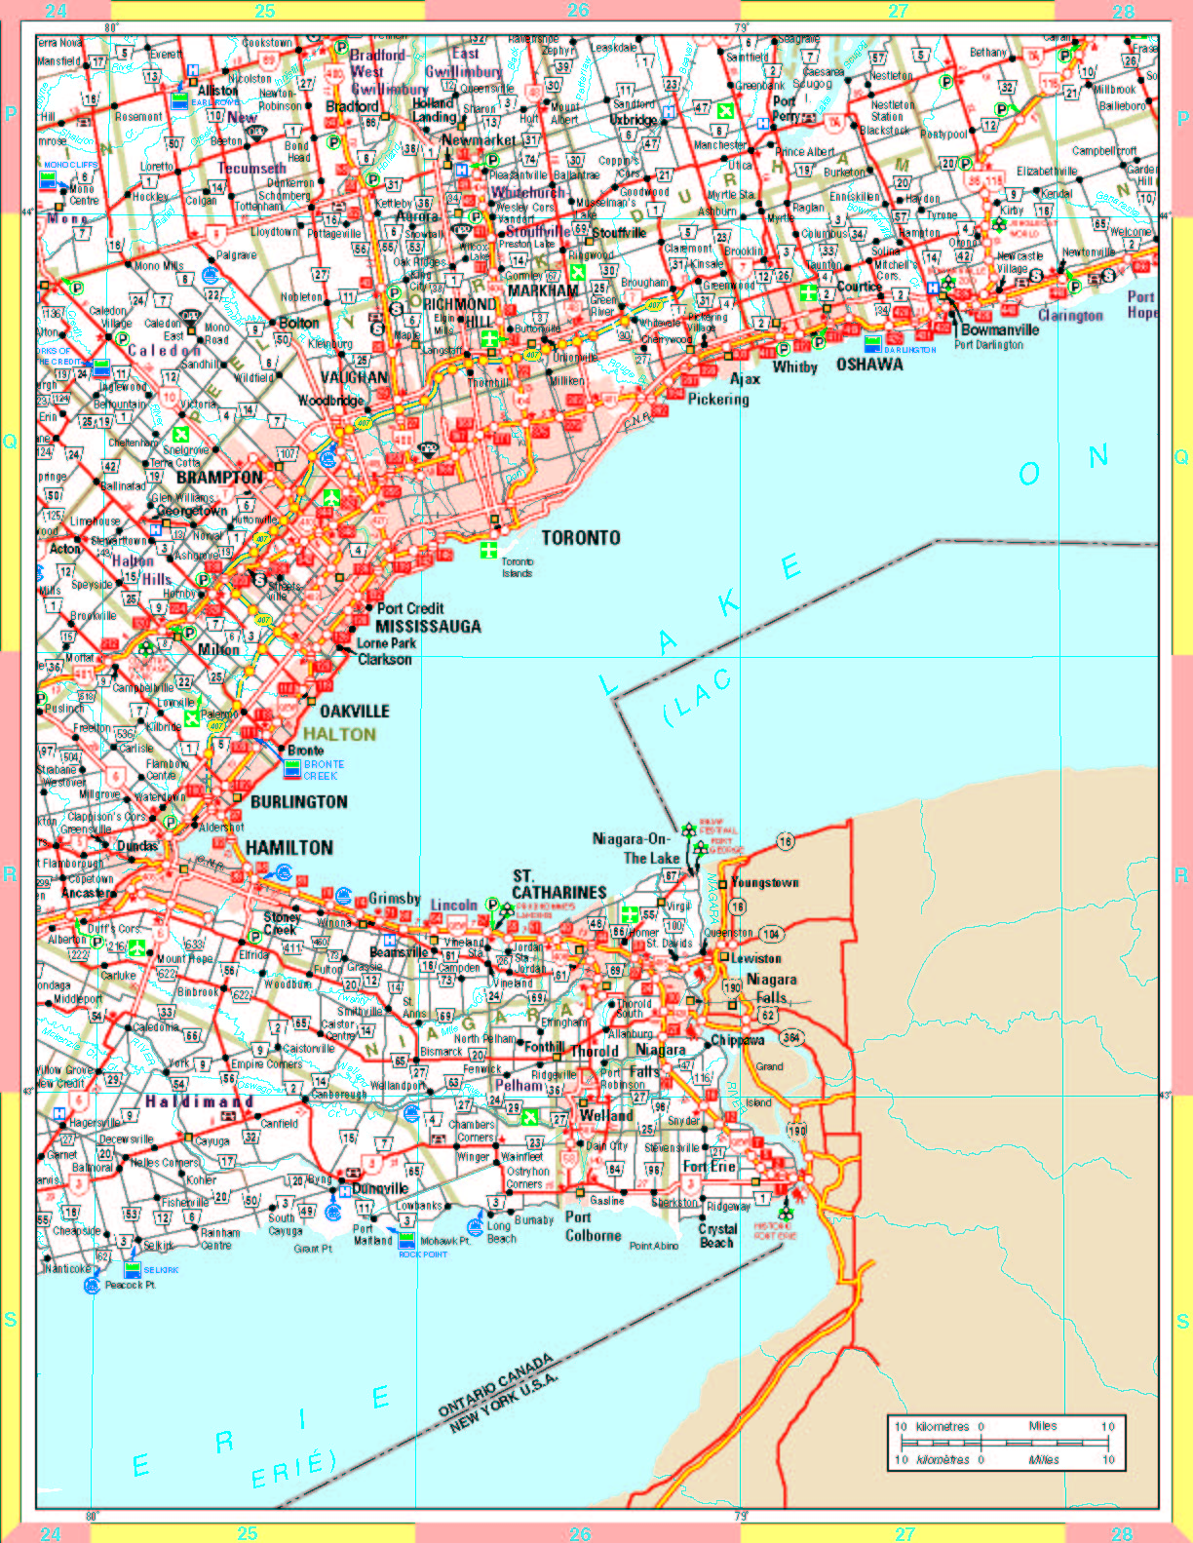
Types of Maps
General Purpose Map of the “Golden Horseshoe” (Niagara Falls to Clarington)

Slide 25
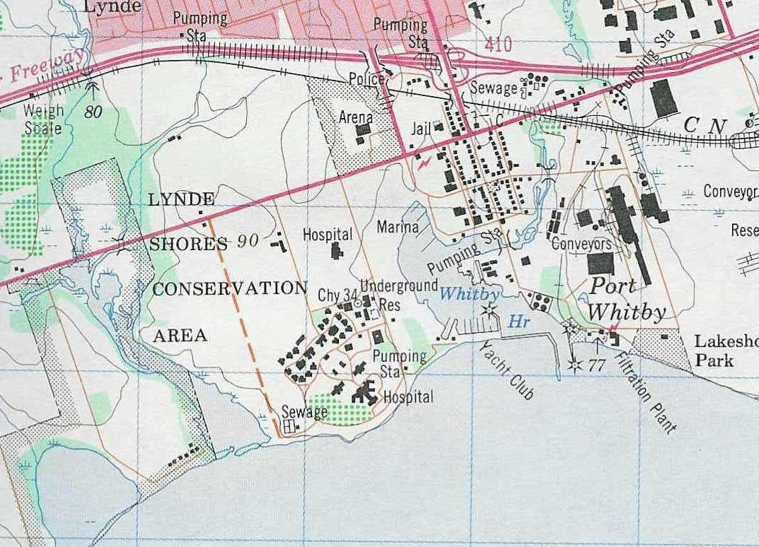
Types of Maps
Topographic Maps
  A map that indicates scale, using symbols and colours for both natural and human features on the Earth’s surface
  Shows the Earth’s surface in great detail (large scale)
  Depicts the height of land features (topography)
  Often shows roads, settlements, vegetation cover, power lines, etc.

Slide 26
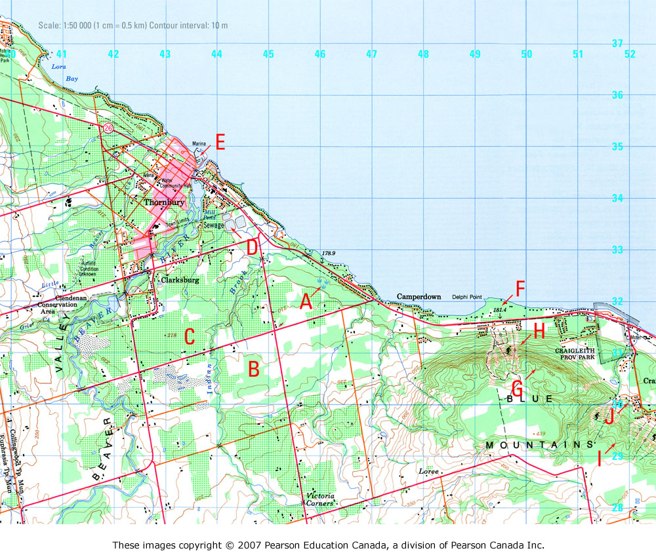
Types of Maps
Topographic Map of Blue Mountain (Collingwood)

Slide 27
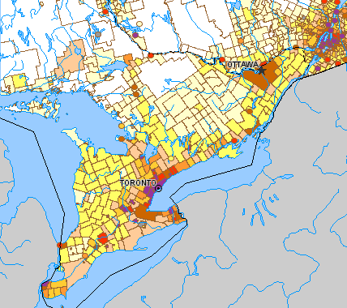
Types of Maps
Thematic Maps
  A map that reveals the geographic patterns of statistical data
  Are designed to display distributions over the Earth’s surface
  Usually focuses on one theme or topic (e.g., population distribution)

Slide 28
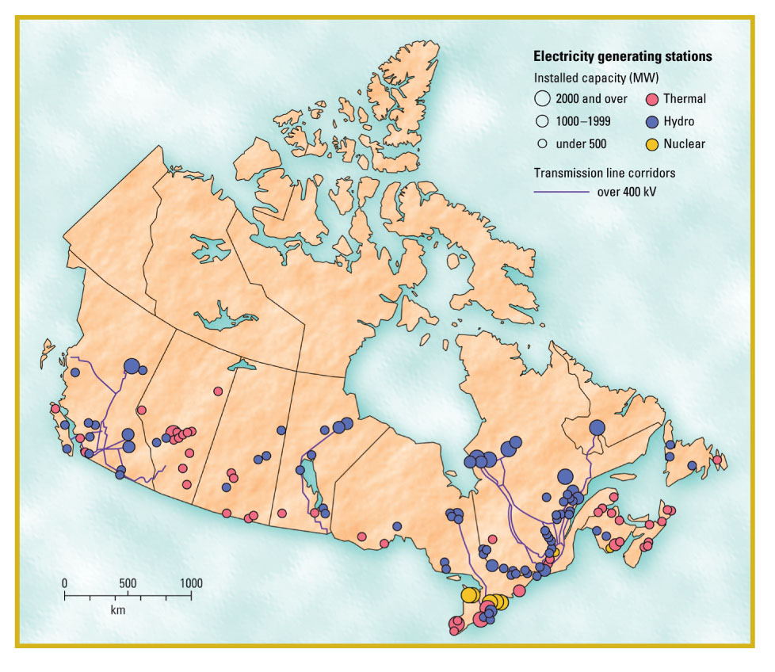
Types of Maps
Thematic map showing electricity generating stations in Canada

Slide 29

Types of Maps
Digital Maps
  Computer programs
  Handheld devices
  Online

Slide 30
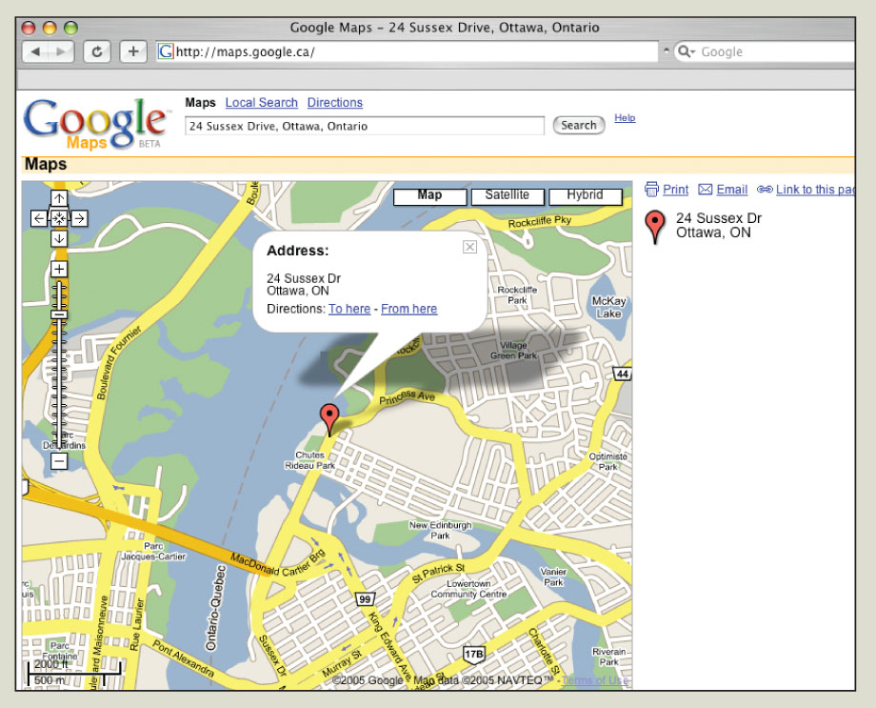
Types of Maps
Google Maps is an example of an online map.
www.maps.google.com

Slide 31
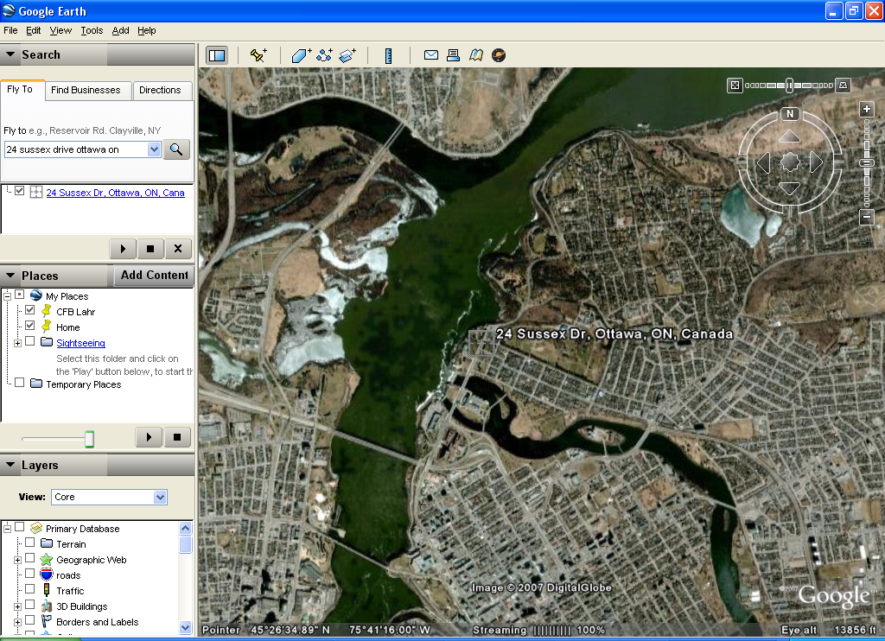
Types of Maps
Google Earth is an example of a computer program using digital maps.
www.earth.google.com

Slide 32
Political Map of Canada
Add to this map:
  Provinces
  Territories
  Capital cities
  “Other” cities
  6 map essentials
  Different coloured provinces*
  First and last name
*You CAN use the same colour more than once, so long as it doesn’t touch a province or territory with that same colour.

Slide 33
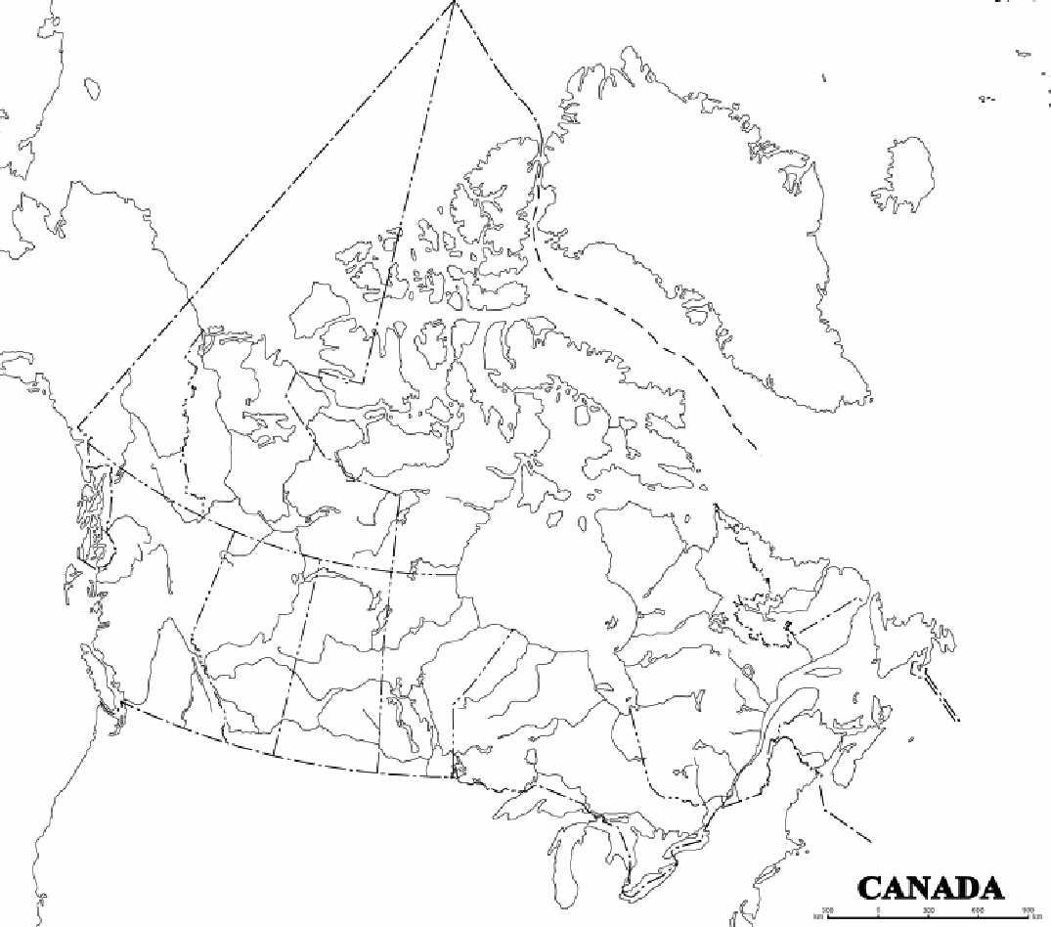
Drainage Map of Canada
Add to this map:
  Oceans, Lakes, Rivers, Bays, and Gulfs as listed on your handout
  6 map essentials
  Canada land coloured green
  All water coloured blue
  All other land coloured grey (or beige)
  First and last name

Slide 34
Pear Island Mapping Exercise
The island is in the shape of a pear
It is exactly 10 km long and 5 km wide
It has a shoreline at 0 m (sea level)
It has a hill at the south end of the island which is 90 m in height…
Read carefully the instructions provided!

