Slide 1
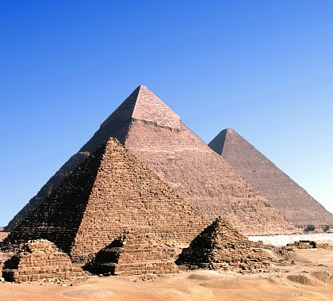
How Ancient Egyptians Traded
http://fountainsafaris.com/UserSiteFiles/public/Egypt/Egypt_Great_Pyramids.jpg

Slide 2
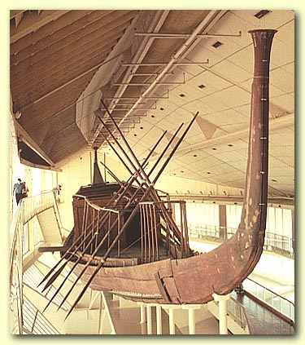
http://library.thinkquest.org/J002046F/travel.htm
They used boats made of papyrus reeds but by 3200 B.C.E timber was being imported from Lebanon.
They also had ferries that would transport civilians that didn’t have boats and these were also used to transport goods.
They would load ships with the goods and products that they were going to trade.
The Nile-River is a huge part of Egyptian trade because they would use it to travel to over great distances.
Being able to travel the distances they could using the river allowed them to have access to trading with whom ever they could sail to.

Slide 3
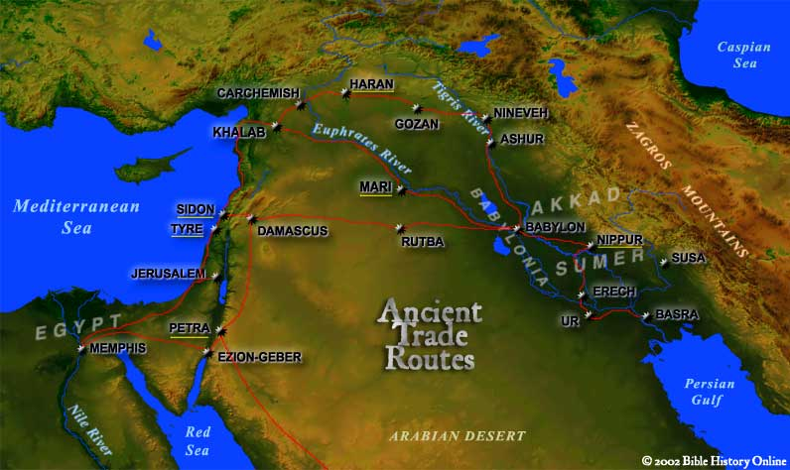
Who They traded With
http://www.bible-history.com/maps/maps/map_ancient_trade_routes_mesopotamia.html

Slide 4
Who they Traded with
Tyre -Erech
Jereusalem -Ur
Memphis -Rutba
Petra -Sidon
Ezion-Geber -Carchemish
Damascus -Babylon
Gozan -Susa
Haran -Basra
Khalab -Mari
Nippur
Ashur
Nineveh

Slide 5
What Ancient Egypt traded
Exported Goods –stone, papyrus, rope, pottery vases, gold vessels, lentils, linen, ox hide, dried fish.
Imported Goods- Horses, cattle, small livestock, cedar wood, silver, copper, valuable minerals from Syria and Palestine and Gold from Nubia.

